Slide 1

API Design Principals
C Daniel Waddell
Solution Architect

Slide 2




About Me
I have been developing software commercially for the last 15 year. In my free time I enjoy mixing live music for local Louisville bands, making movies, and developing video games.
https://github.com/cdwaddell
https://www.linkedin.com/in/cdwaddell
@cdanielwaddell

Slide 3
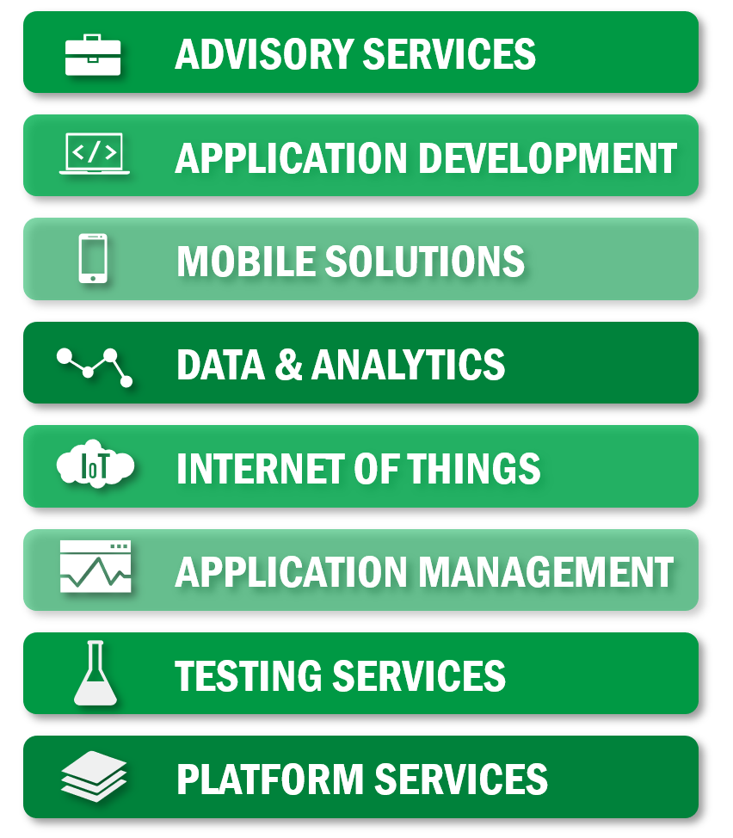
We are exceptional at:
We’re an IT solutions company that solves tough technology challenges so you can get back to business better than usual.

Slide 4
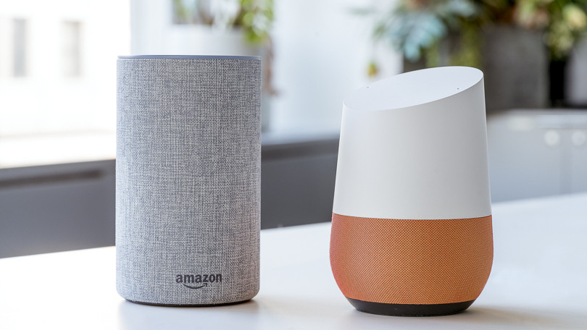
What is an API?
Hello, is anyone there?
No

Slide 5

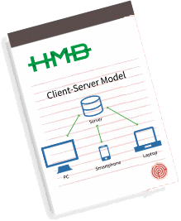

Slide 6
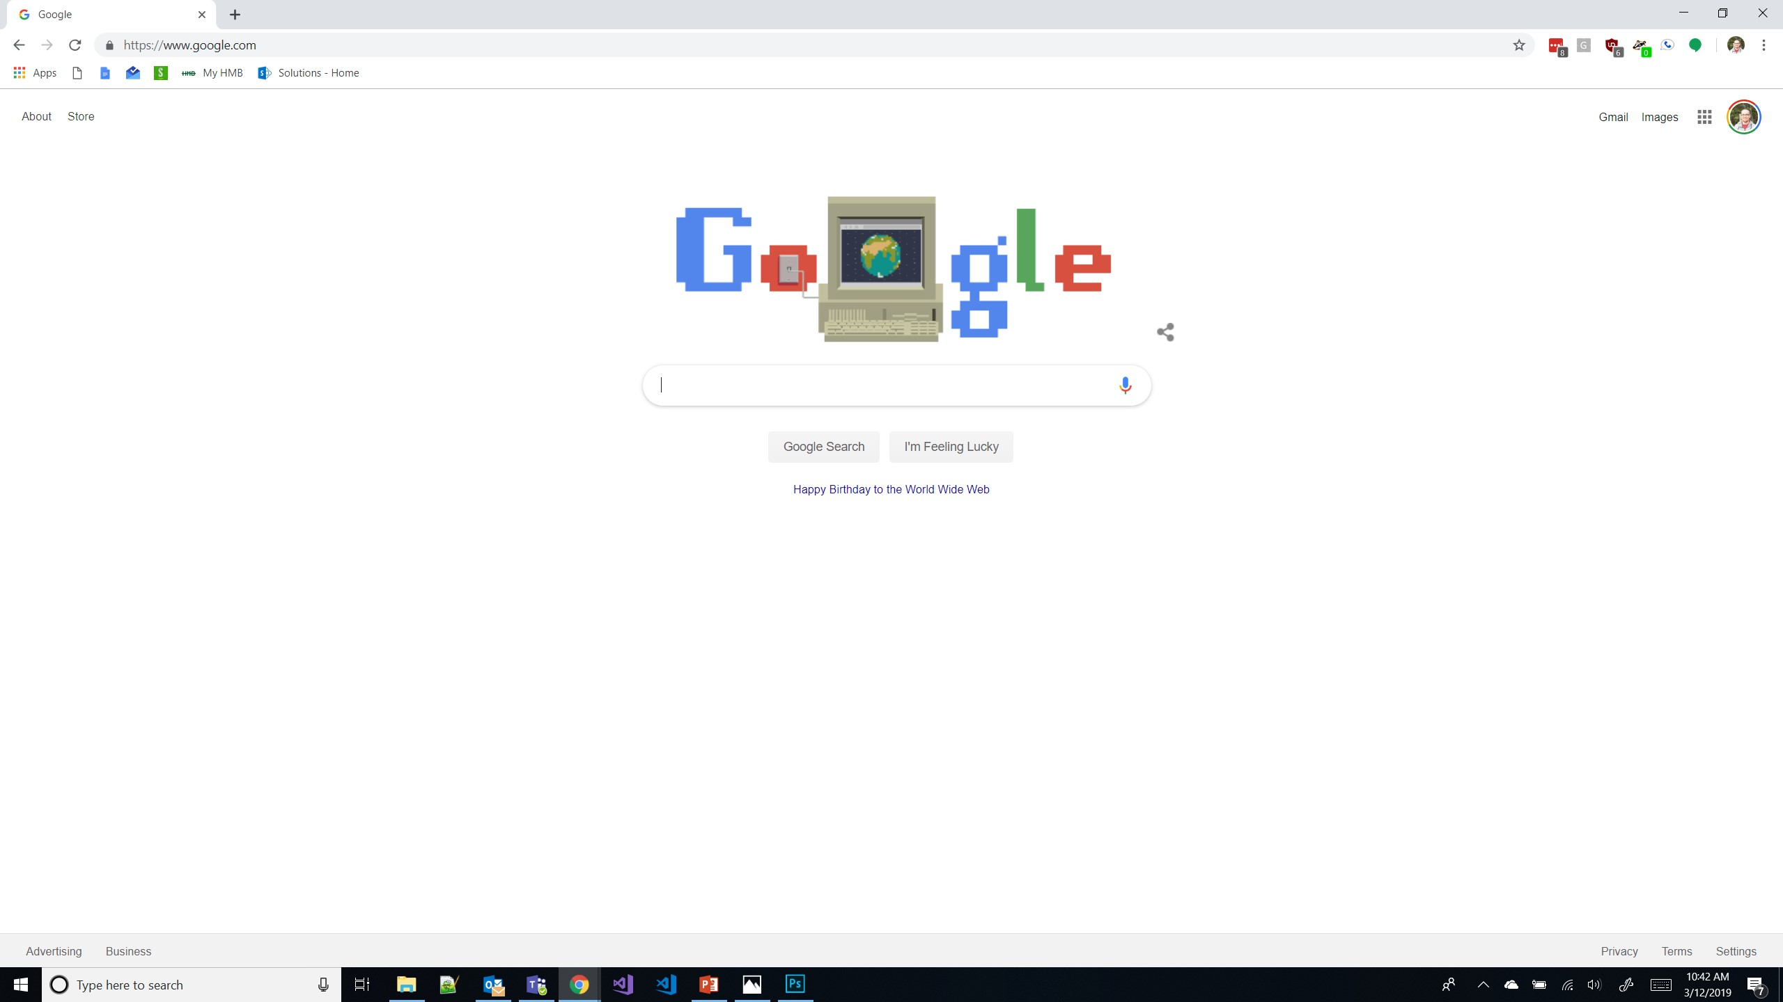
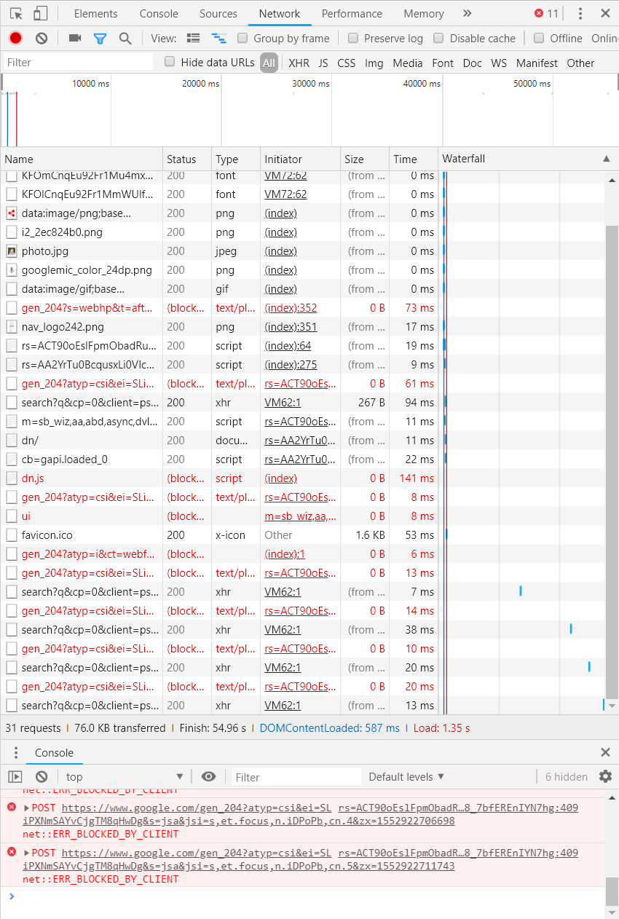

Slide 7
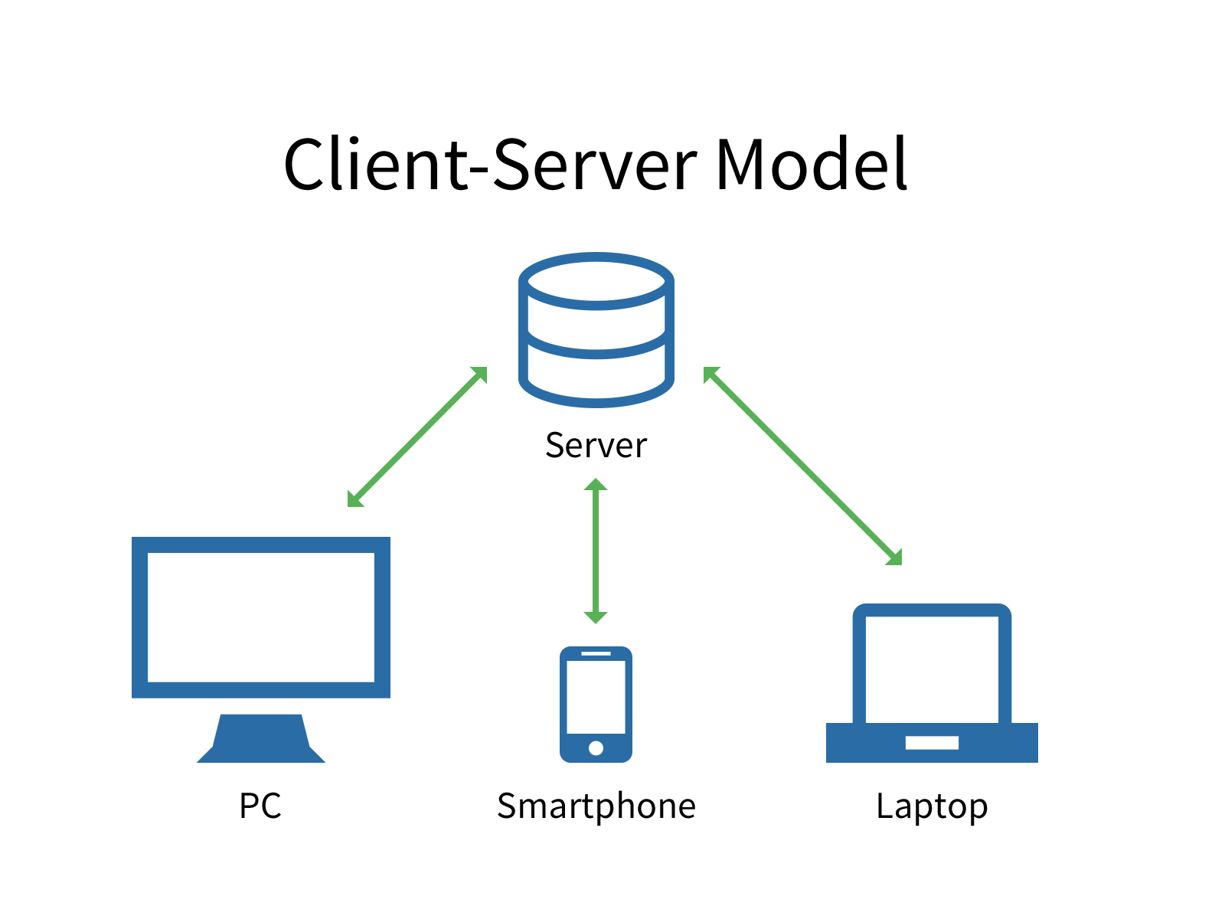
Why us a web API?
Shared business logic layer.
Instantly updatable for all users of your system.
Usage can be analyzed, reviewed, and used to drive decisions.

Slide 8


Slide 9
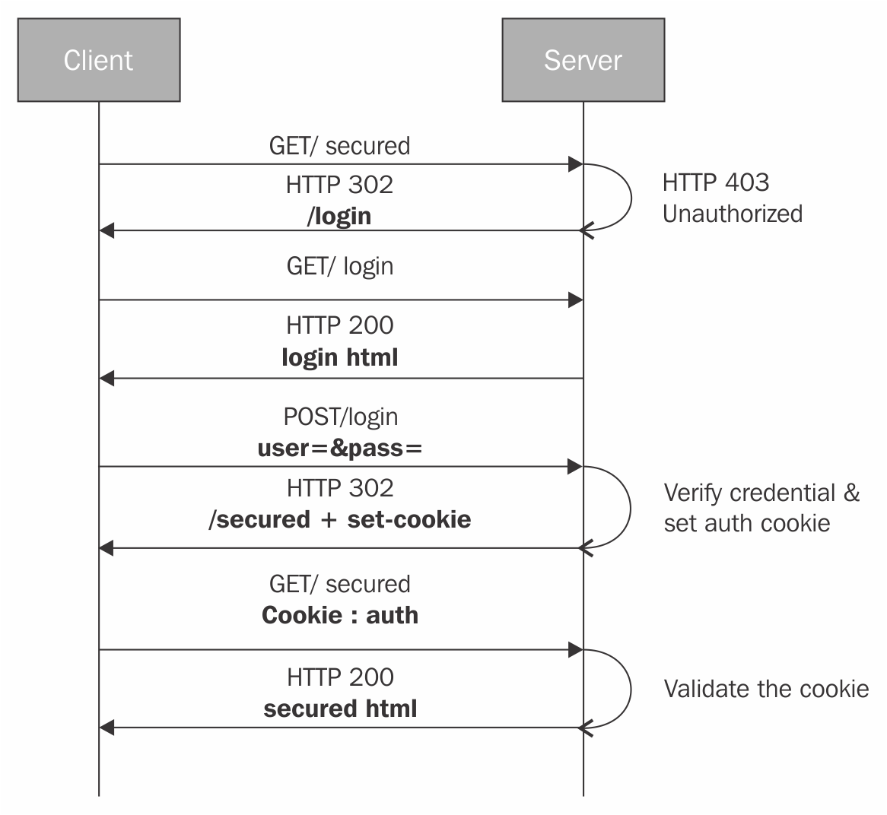
Cookie-Based Authentication
Great for single site applications
Usually used in conjunction with a single sign on solution
Optionally persistent

Slide 10
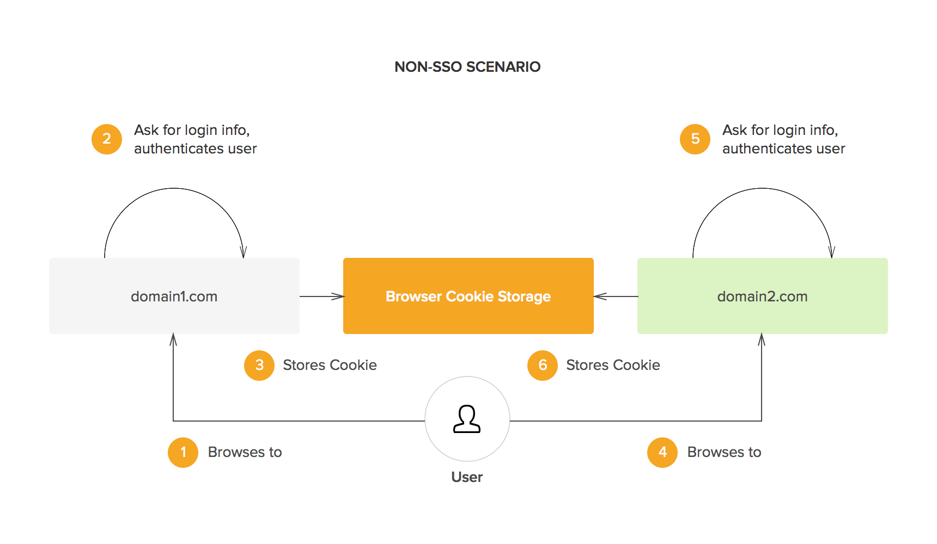

Slide 11
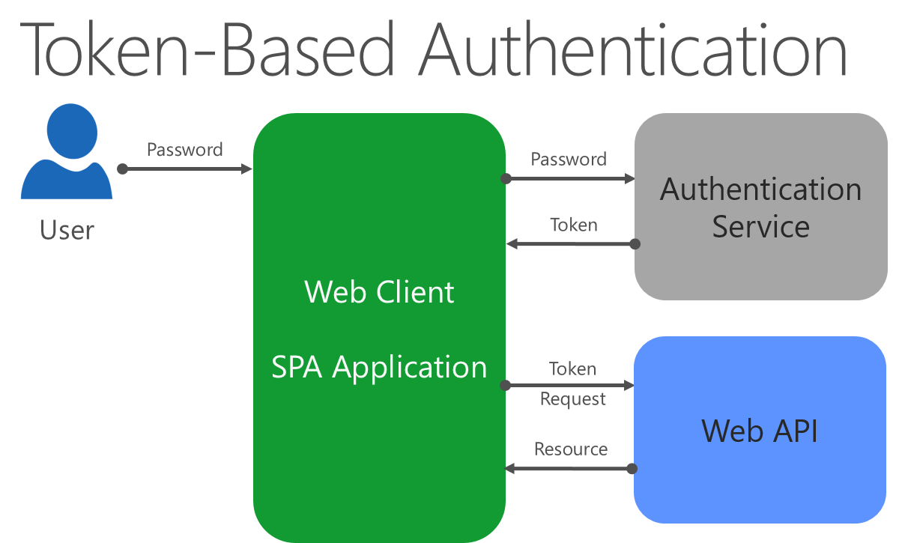

Slide 12
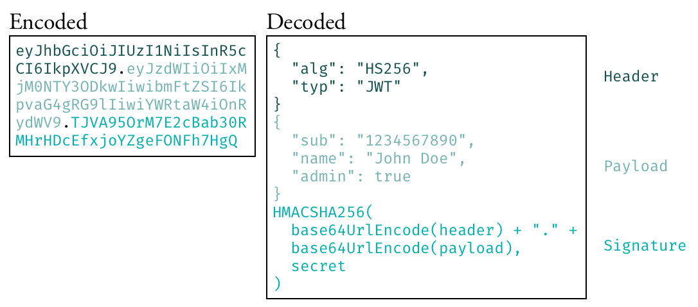
Tokens, Tokens, Tokens and OAuth/OpenId

Slide 13
Best Practices of Web API Design
Intelligent Versioning
Use HTTP Verbs to communicate intent
Use HTTP Status Codes
Predefine an error response
Endpoints should be nouns, not verbs
GET requests and query parameters should never alter state
Filter, Paging, and Sorting

Slide 14
Versioning
By Uri
http://api.example.com/v1
http://apiv1.example.com
By Custom Request Header
GET http://api.example.com/
Accept: application/json
Accept-version: v1
By Accept header
GET http://api.example.com/
Accept: application/json;version=1.0
If the data you expect from the user changes in a breaking way.
If the data you are sending to a user changes in a breaking way.
Deprecating an existing API endpoint.

Slide 15
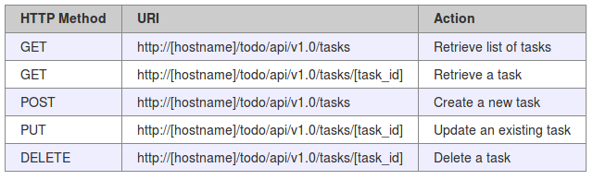
Using HTTP Verbs
GET – Retreives a resource or a list of resource
POST – Updates or Creates a new resource
PUT – Updates a resource by ID
DELETE – Removes a resource or a sub-resource
Allow overriding HTTP method X-HTTP-Method-Override

Slide 16
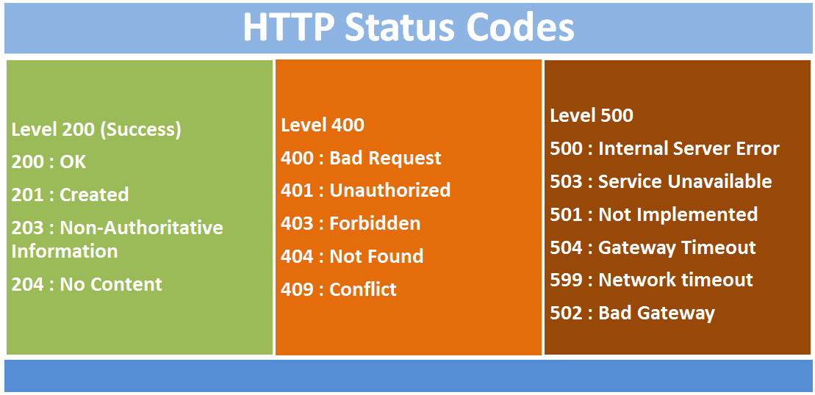

Slide 17
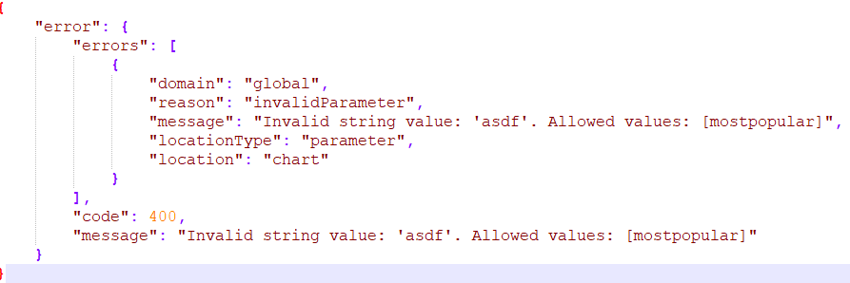
Error Response Payloads

Slide 18
Resources based, not action based
REST is about identifying resource, if you can’t identify a resource based on an API URL, then you should reconsider the design.
* sometimes verbs can be a resource
GET /api/v1.0/movies
GET /api/v1.0/movies/1254
GET /api/v1.0/movies/1254/actors
POST /api/v1.0/movies/1254/actors
POST /api/v1.0/movies/1254/actors/137/moveto/3454

Slide 19
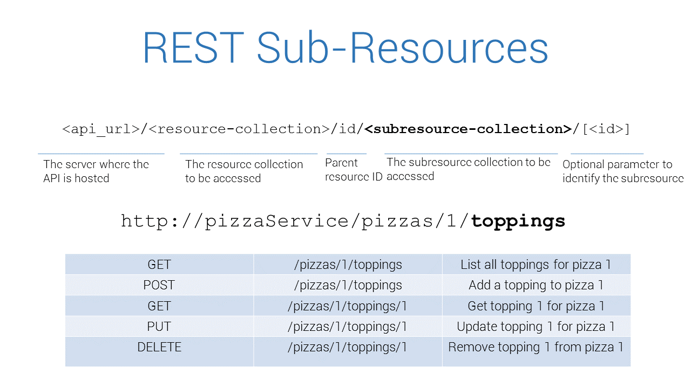

Slide 20
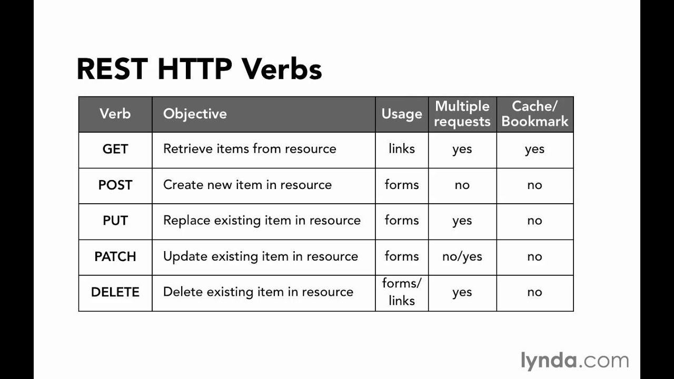
Idempotence

Slide 21

Stop… Demo Time

Slide 22
Other Guidelines
Don’ts
Don't Make the Client Do Anything the Module Could Do
Don't Violate the Principle of Least Astonishment
Don’t Design for Single User Scenarios, follow the “Rule of Threes”
Dos
Make your API as small as possible (but no smaller)
Use HTTP Headers
Make your API internally consistent
User real world objects
Make your API status visible

Slide 23
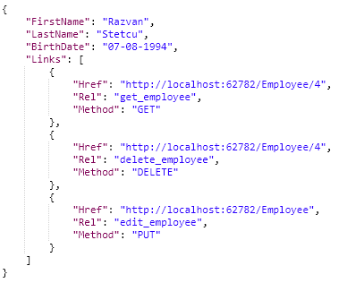
HATEOAS
Hypermedia as the Engine of Application State
Resource Locator Pattern
Clients should not build up URLs

Slide 24


ROCA – REST for client side
Resource-oriented Client Architecture
No session that may expire.
Bookmarkable URLs for everything.
Easier integration of different applications.
Applications don’t have to become big monoliths, it’s easy to split functionality up.
Back and forward buttons always work.

Slide 25
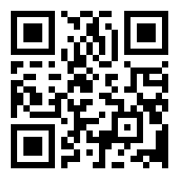
Thanks!
https://goo.gl/TdLmvk
https://github.com/cdwaddell/APIDesignPrincipals

